Slide 1
Chapter 1
Introduction to Computers and the Internet

Slide 2
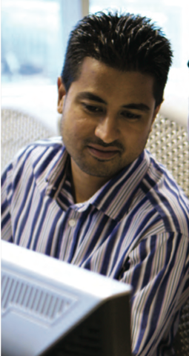
Learning Objectives
Explain what computers do
Identify types of computers
Describe computer networks and the Internet
Understand how computers impact society

Slide 3
What is a Computer?
Topics Covered:
Data vs. Information
Hardware and Software
Computer Users and Professionals
Cloud Computing

Slide 4
What is a Computer?
A computer is a programmable, electronic device that does the following:
Accepts data
Performs operations on data
Presents the results
Stores data or results as needed

Slide 5
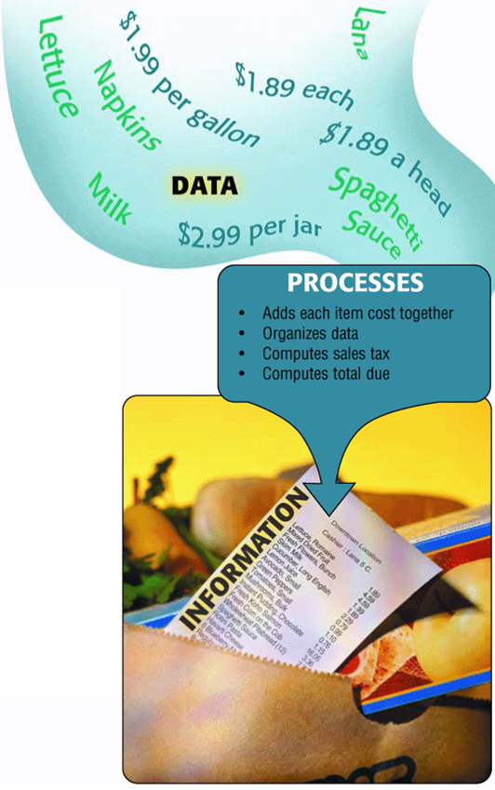
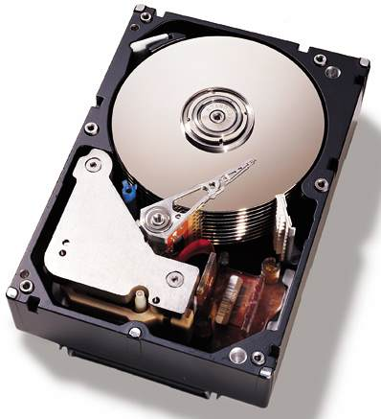
What is a Computer?
The primary four operations of a computer are:
Input Data
Process
Output Information
Store Data
Known as the information processing cycle.

Slide 6
What is a Computer?
Today’s computers also typically perform communications functions
sending or retrieving data via the Internet
accessing information located in a shared company database
exchanging email messages.

Slide 7
Data vs. Information
A user inputs data into a computer, and the computer processes it.
When data is processed, into a meaningful or useful form, it becomes information.
Data that is not meaningful or useful after process is know by the term Garbage In Grabage Out (GIGO).

Slide 8
Hardware and Software
The physical parts of a computer (the parts you can touch) are called hardware.
The term software refers to the programs or instructions used to tell the computer hardware what to do and to allow people to use a computer to perform specific tasks

Slide 9
Computer Users and Professionals
Computer users, often called end users, are the people who use computers to perform tasks or obtain information.
Programmers, on the other hand, are computer professionals who write the programs that computers use.
Other computer professionals include:
Systems analysts
Computer operations personnel
Security specialists

Slide 10
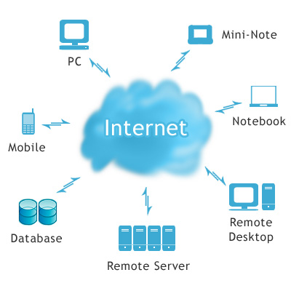
Cloud Computing
In general, cloud computing refers to data, applications, and even resources stored on computers accessed over the Internet
You are working in a “cloud” of computers—rather than on users’ computers, and you access only what you need when you need it.

Slide 11
Types of Computers
Topics Covered:
Embedded Computers
Mobile Devices
Computers Then and Now
Personal Computers
Midrange Servers
Mainframe Computers
Supercomputers

Slide 12
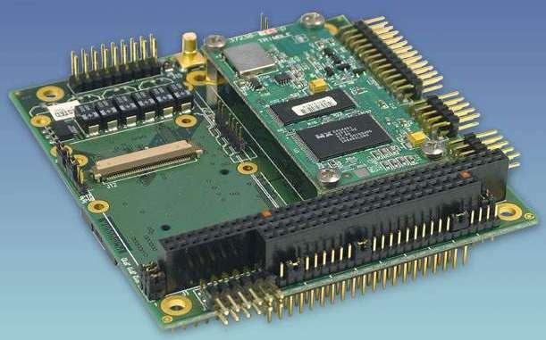
Embedded Computers
An embedded computer is a tiny computer embedded into a product designed to perform specific tasks or functions for that product.
Used in appliances.

Slide 13
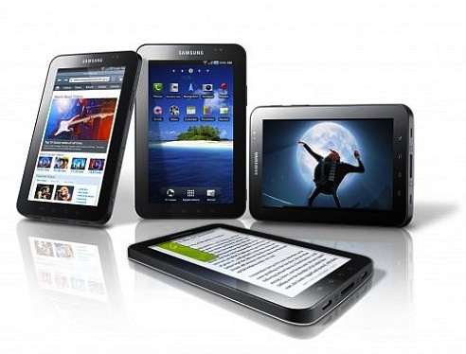
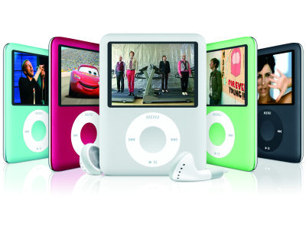
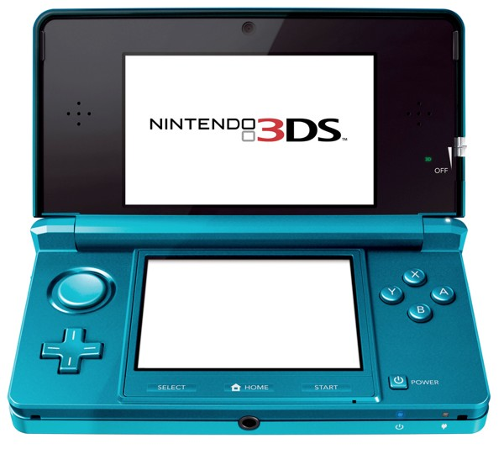
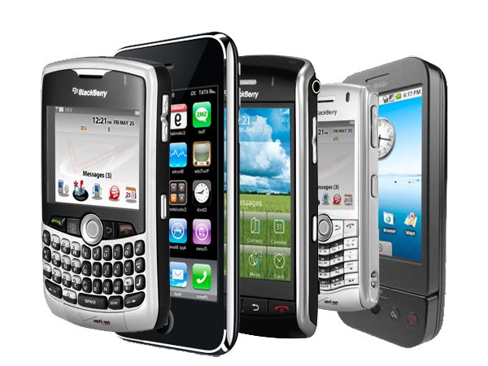
Mobile Devices
A mobile device is loosely defined as a very small communications device, such as
Smart Phones
Gaming Devices
Music Players
Tablet PC’s

Slide 14
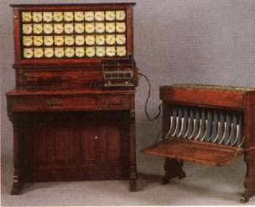
Computers Then and Now
Before 1946: Precomputers and Early Computers

Slide 15
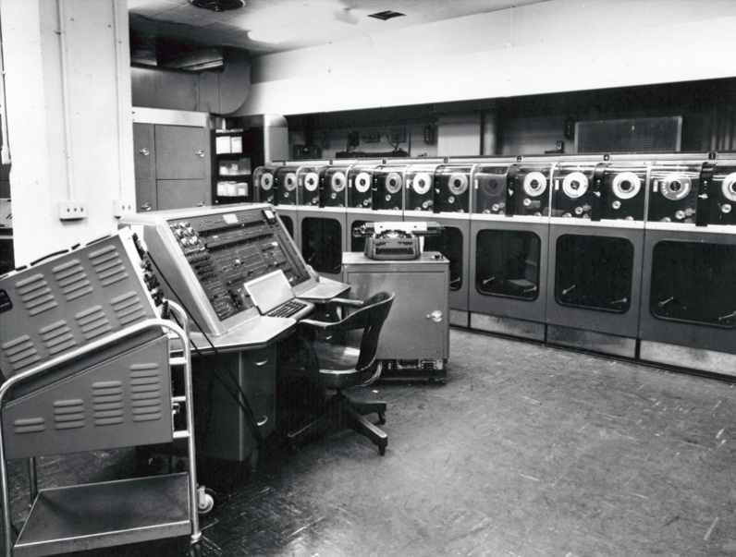
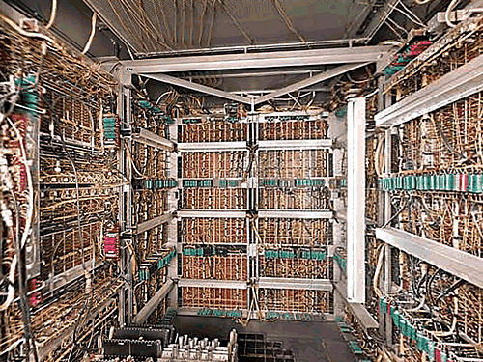
Computers Then and Now
Approx. 1946-1957: First-Generation Computers
Large room sized
Used paper puch cards and tapes
UNIVAC was the first mass produced computer.

Slide 16
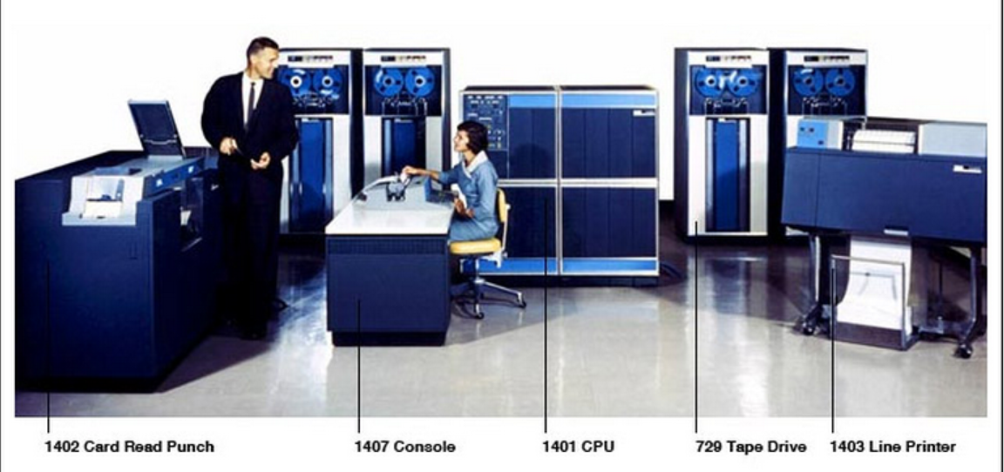
Computers Then and Now
1958-1963: Second-Generation Computers – IBM 1401

Slide 17
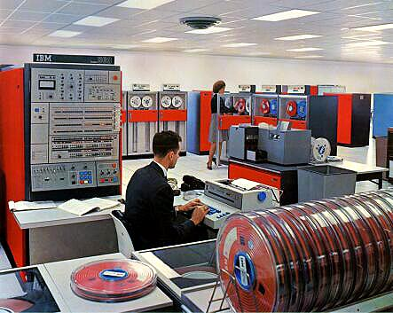
Computers Then and Now
1964-1970: Third-Generation Computers – IBM/System 360 IC’s

Slide 18
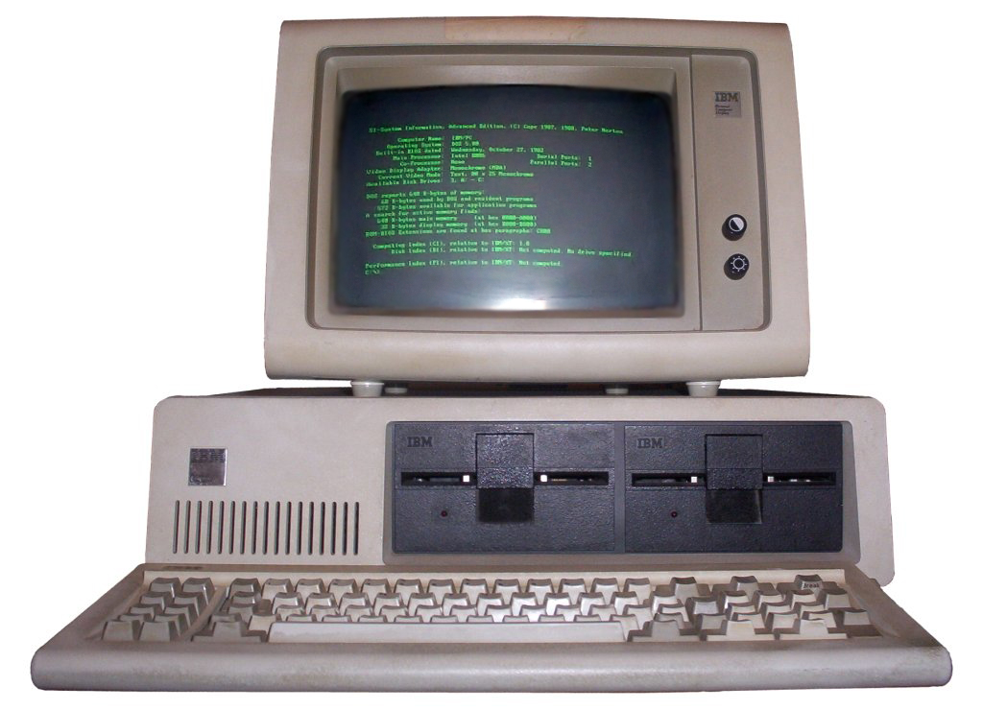
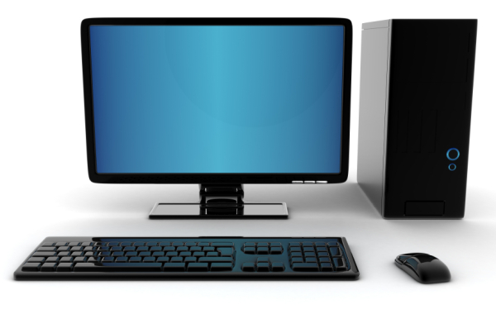
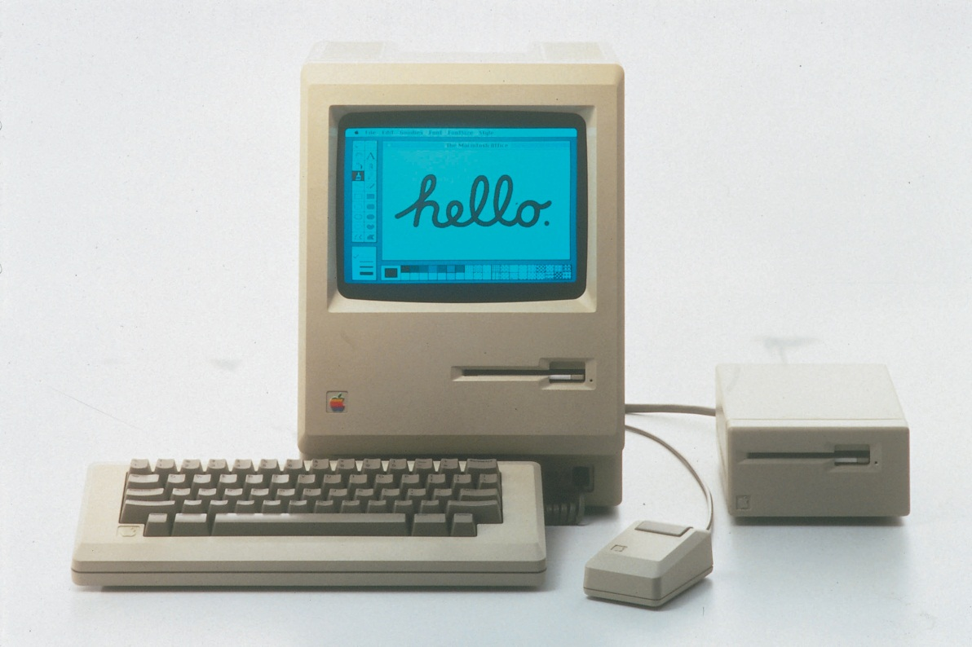
Computers Then and Now
Approx. 1971-Present: Fourth-Generation Computers
Introduction of the CPU
Apple Macintosh
IBM 5150

Slide 19
Personal Computers (PCs)
A personal computer (PC) is a small
computer designed to be used by
one person at a time.
Desktop computers.
Portable computers - computers that are designed to be carried around easily
Internet appliances.- designed primarily for accessing Web pages and/or exchanging email

Slide 20
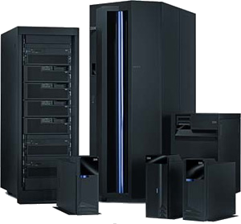
Midrange Servers
A midrange server (sometimes called a minicomputer) is a medium-sized computer used to host programs and data for a small network.
One trend involving midrange servers, as well as the mainframe computers, is virtualization.

Slide 21
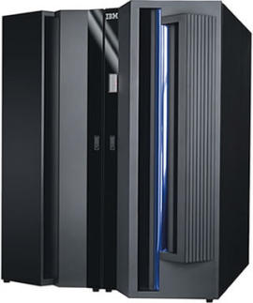
Mainframe Computers
A mainframe computer is a powerful computer used in many large organizations that need to manage large amounts of centralized data.

Slide 22
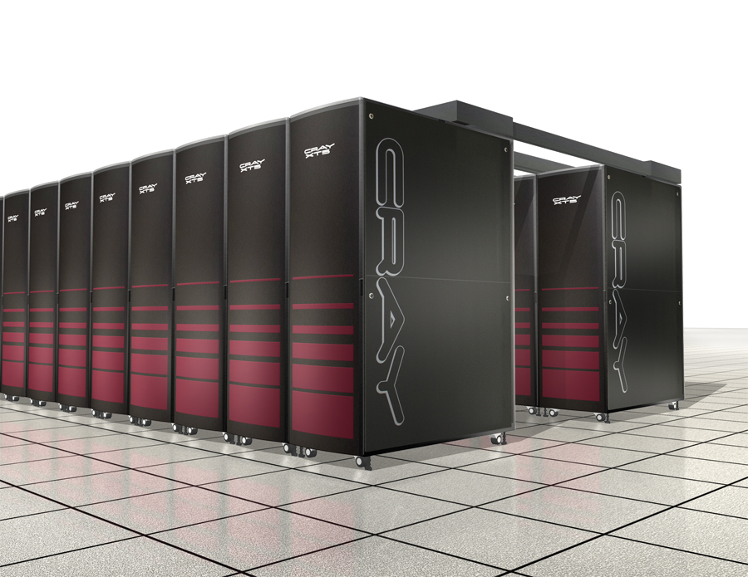
Supercomputers
Supercomputers are the most powerful and most expensive type of computer available.
To reduce the cost, supercomputers are often built by connecting hundreds of smaller and less expensive computers into a supercomputing cluster that acts as a single supercomputer.

Slide 23
Computer Networks and the Internet
A network is a collection of computers and other devices that are connected to share hardware, software, and data.

Slide 24
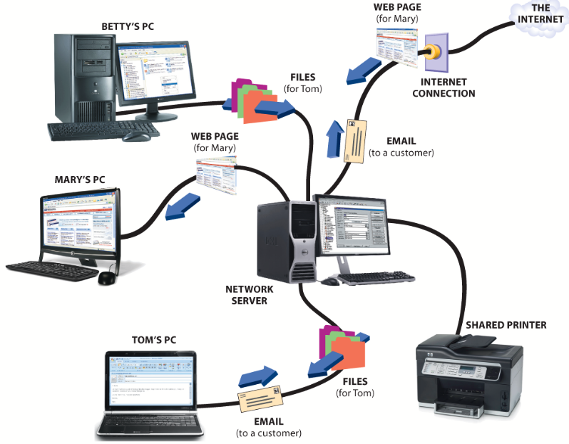

Slide 25
The Internet and the World Wide Web
The Internet is a worldwide collection of networks that link together millions of businesses, governments, educational institutions, and individuals.
Each of these networks provides resources and data that add to the abundance of goods, services, and information accessible via the Internet.

Slide 26
The Internet and the World Wide Web - Connecting to the Internet
Slow speed technology
Dial-up access
High speed technology
Digital subscriber line (DSL)
Cable television Internet services (CATV),
Satellite
Wireless Broadband
Connection is always on

Slide 27
The Internet and the World Wide Web – Services Provided
Services Provided
E-mail
File Transfer Protocol
World Wide Web
Streaming media
Chat rooms and message boards.
These services are called protocols in the computer world.
A protocol is a standard procedure for regulating data transmission between computers

Slide 28
The Internet and the World Wide Web - Services Provided
WWW
E-mail
Streaming Media
FTP

Slide 29
The Internet and the World Wide Web - How Data is Sent
Data is divided into packets
Packets are sent across the Internet using various types of equipment
Packets are reassembled at receiving computer

Slide 30
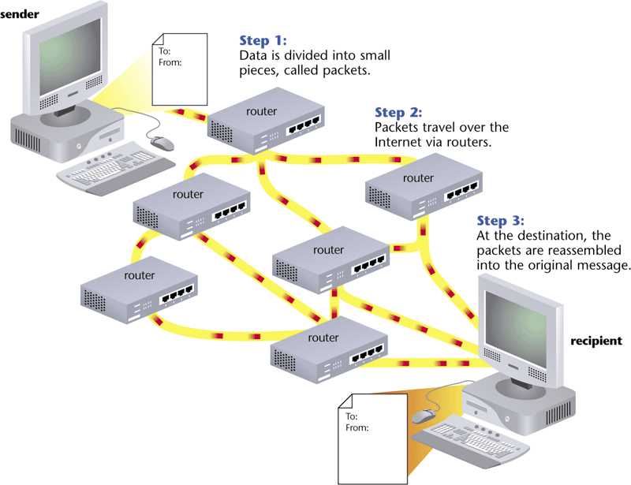
The Internet and the World Wide Web - How Data is Sent

Slide 31
The Internet and the World Wide Web
The World Wide Web, or simply Web, consists of a worldwide collection of electronic documents, Web pages, organized into Web sites
It is made up of three main parts.
Backbone
Internet
Cloud
Client
Server

Slide 32
The Internet and the World Wide Web - Addressing
The Internet Protocol Address or IP Address
Known as the dotted quad xxx.xxx.xxx.xxx
Number that uniquely identifies each computer or device connected to Internet
Domain Name is the text version of IP Address
www.amazon.com = 207.171.166.252

Slide 33
The Internet and the World Wide Web - URL
The Uniform Resource Locator (URL) - Unique address for a web page located on a specific web server

Slide 34
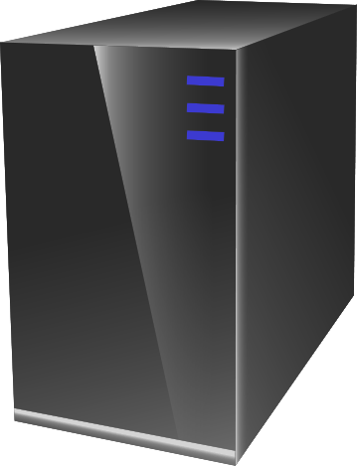
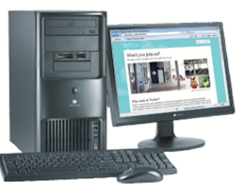

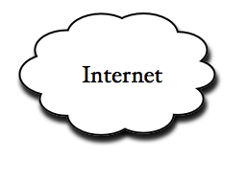
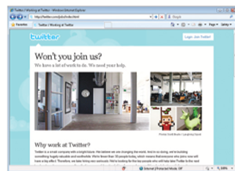
The Internet and the World Wide Web - URL
Twitter
server
Jobs
protocol
http://twitter.com/jobs/index.html
http://twitter.com/jobs

Slide 35
Email
Email is the process of ex- changing messages between computers over a network— usually the Internet.
domain
name
user name
samjohnson@scsite.com

Slide 36
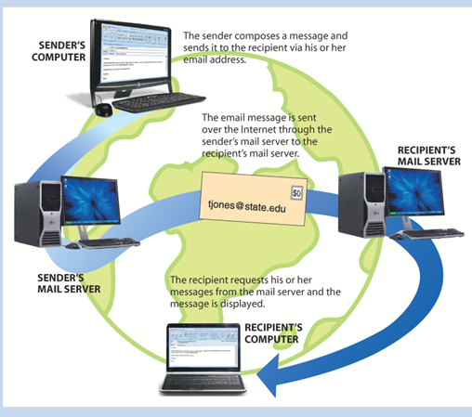
Email

Slide 37

Computers and Society
Topics Covered:
Benefits and Risks of a Computer-Oriented Society
Understanding Intellectual Property Rights
Computers and Health
Environmental Concerns

Slide 38
Benefits and Risks of a Computer-Oriented Society
Benefits:
Faster and easier access to information.
Ability to shop, pay bills and perform other financial tasks
Instant communication through online web sites such as twitter
Increased efficiency in routine tasks

Slide 39
Benefits and Risks of a Computer-Oriented Society
Risks:
Stress and health concerns
Security and privacy
Legal and ethical dilemmas

Slide 40
Understanding Intellectual Property Rights
Intellectual property rights are the legal rights to which the creators of intellectual property (original creative works) are entitled.
Copyright
Protection available to the creator of an original artistic, musical, or literary work
Gives the copyright holder the exclusive right to publish, reproduce, distribute, perform, or display the work.

Slide 41
Understanding Intellectual Property Rights
Anyone wishing to use copyrighted materials must first obtain permission from the copyright holder and pay any required fee.
Fair Use - permits limited duplication and use of a portion of copyrighted material for specific purposes, such as criticism, commentary, news reporting, teaching, and research.
Trademark - a word, phrase, symbol, or design that identifies goods or services.
Plagiarism - To present someone else’s work as your own

Slide 42
Ethics
Ethics refers to standards of moral conduct.
Computer ethics ethics with respect to the use of computers
Business ethics are the standards of conduct that guide a business’s policies, decisions, and actions.

Slide 43
Computers and Health
Common physical conditions caused by computer use include eyestrain, blurred vision, fatigue, headaches, backaches, and wrist and finger pain.
Some conditions are classified as repetitive stress injuries (RSIs), in which hand, wrist, shoulder, or neck pain is caused by performing the same physical movements over and over again.

Slide 44
Workspace Design
Ergonomics is the science of fitting a work environment to the people who work there

Slide 45
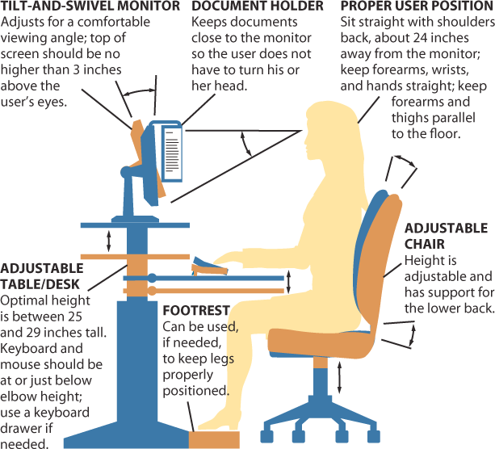
Workspace Design

Slide 46
Environmental Concerns
Green computing refers to the use of computers in an environmentally friendly manner.
In order to reduce e-trash in landfills, consider other options for disposing of old computer equipment.

